Slide 1
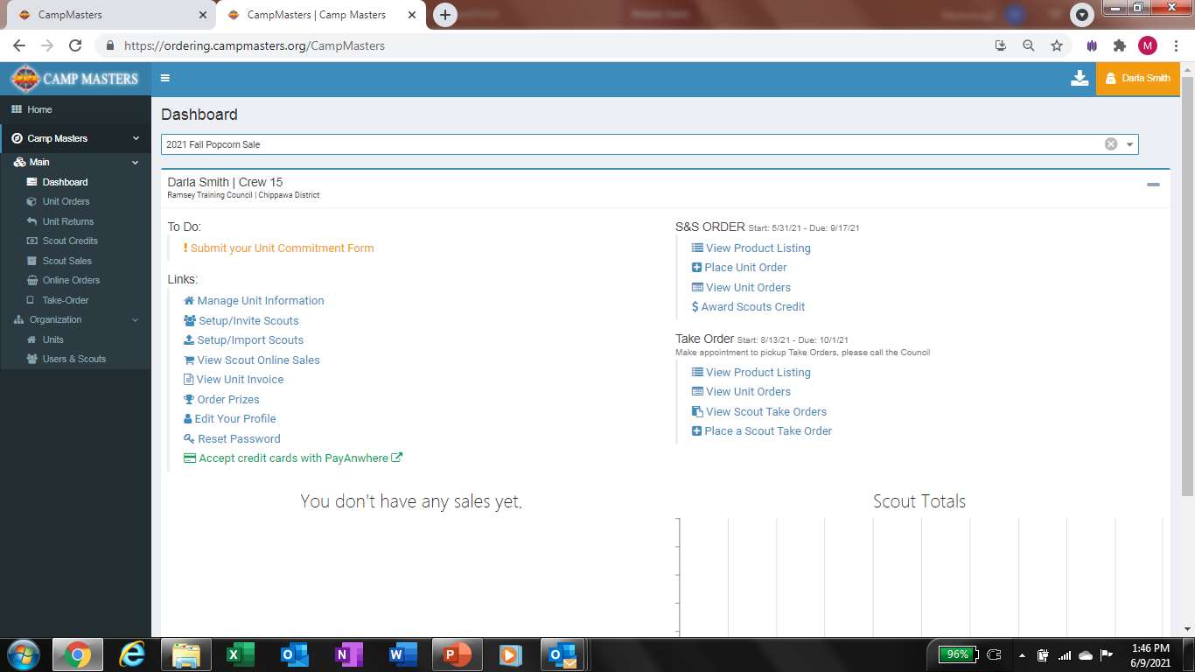
Click under To Do on
“! Submit Unit Commitment Form”

Slide 2
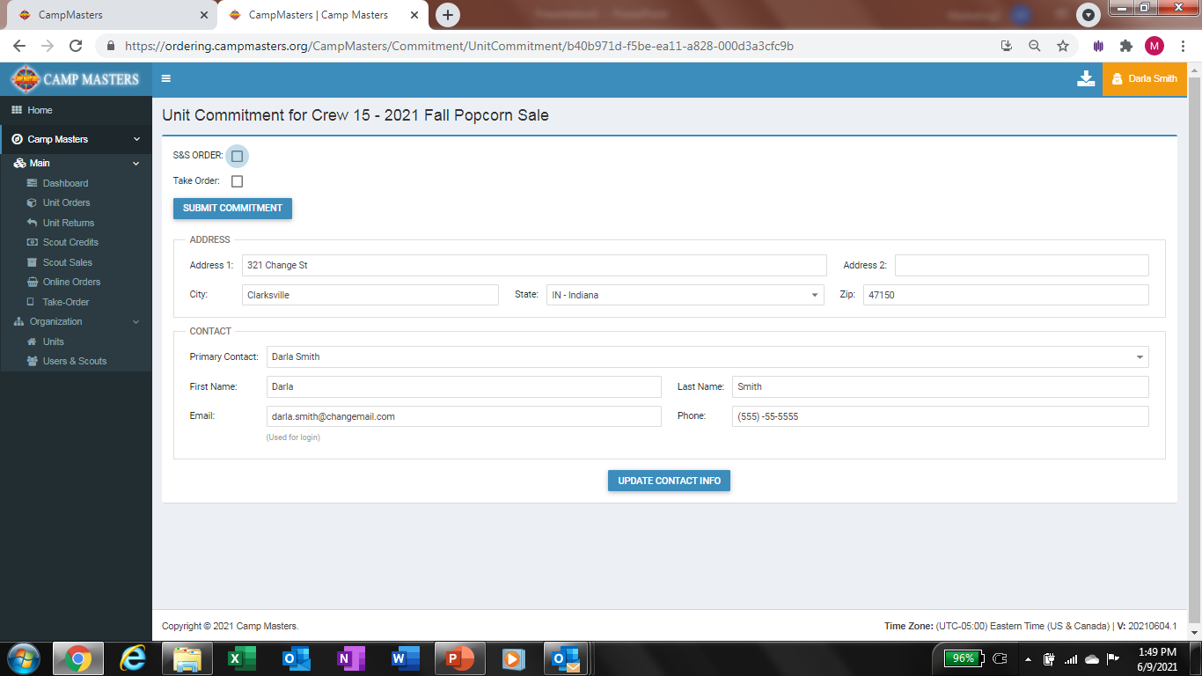
Click on Sale Type you wish to participate in
Update any contact information that needs changed then click on “Update Contact Info” and submit Commitment at the top. This will show the Council you are Committed to the Sale Types checked

