Slide 1


Welcome
Peanut & Popcorn Fundraiser/Training & Overview 2026

Slide 2


It’s going to be an AWESOME Year !!
This year, our Pack is
planning to:
Activity One Date One
Activity Two Date Two
Activity Three Date Three
Activity Four Date Four
Notes:
Customize for your unit: Add the activities your unit plans to do this year.

Slide 3

How are we going to do all this fun stuff?

Slide 4

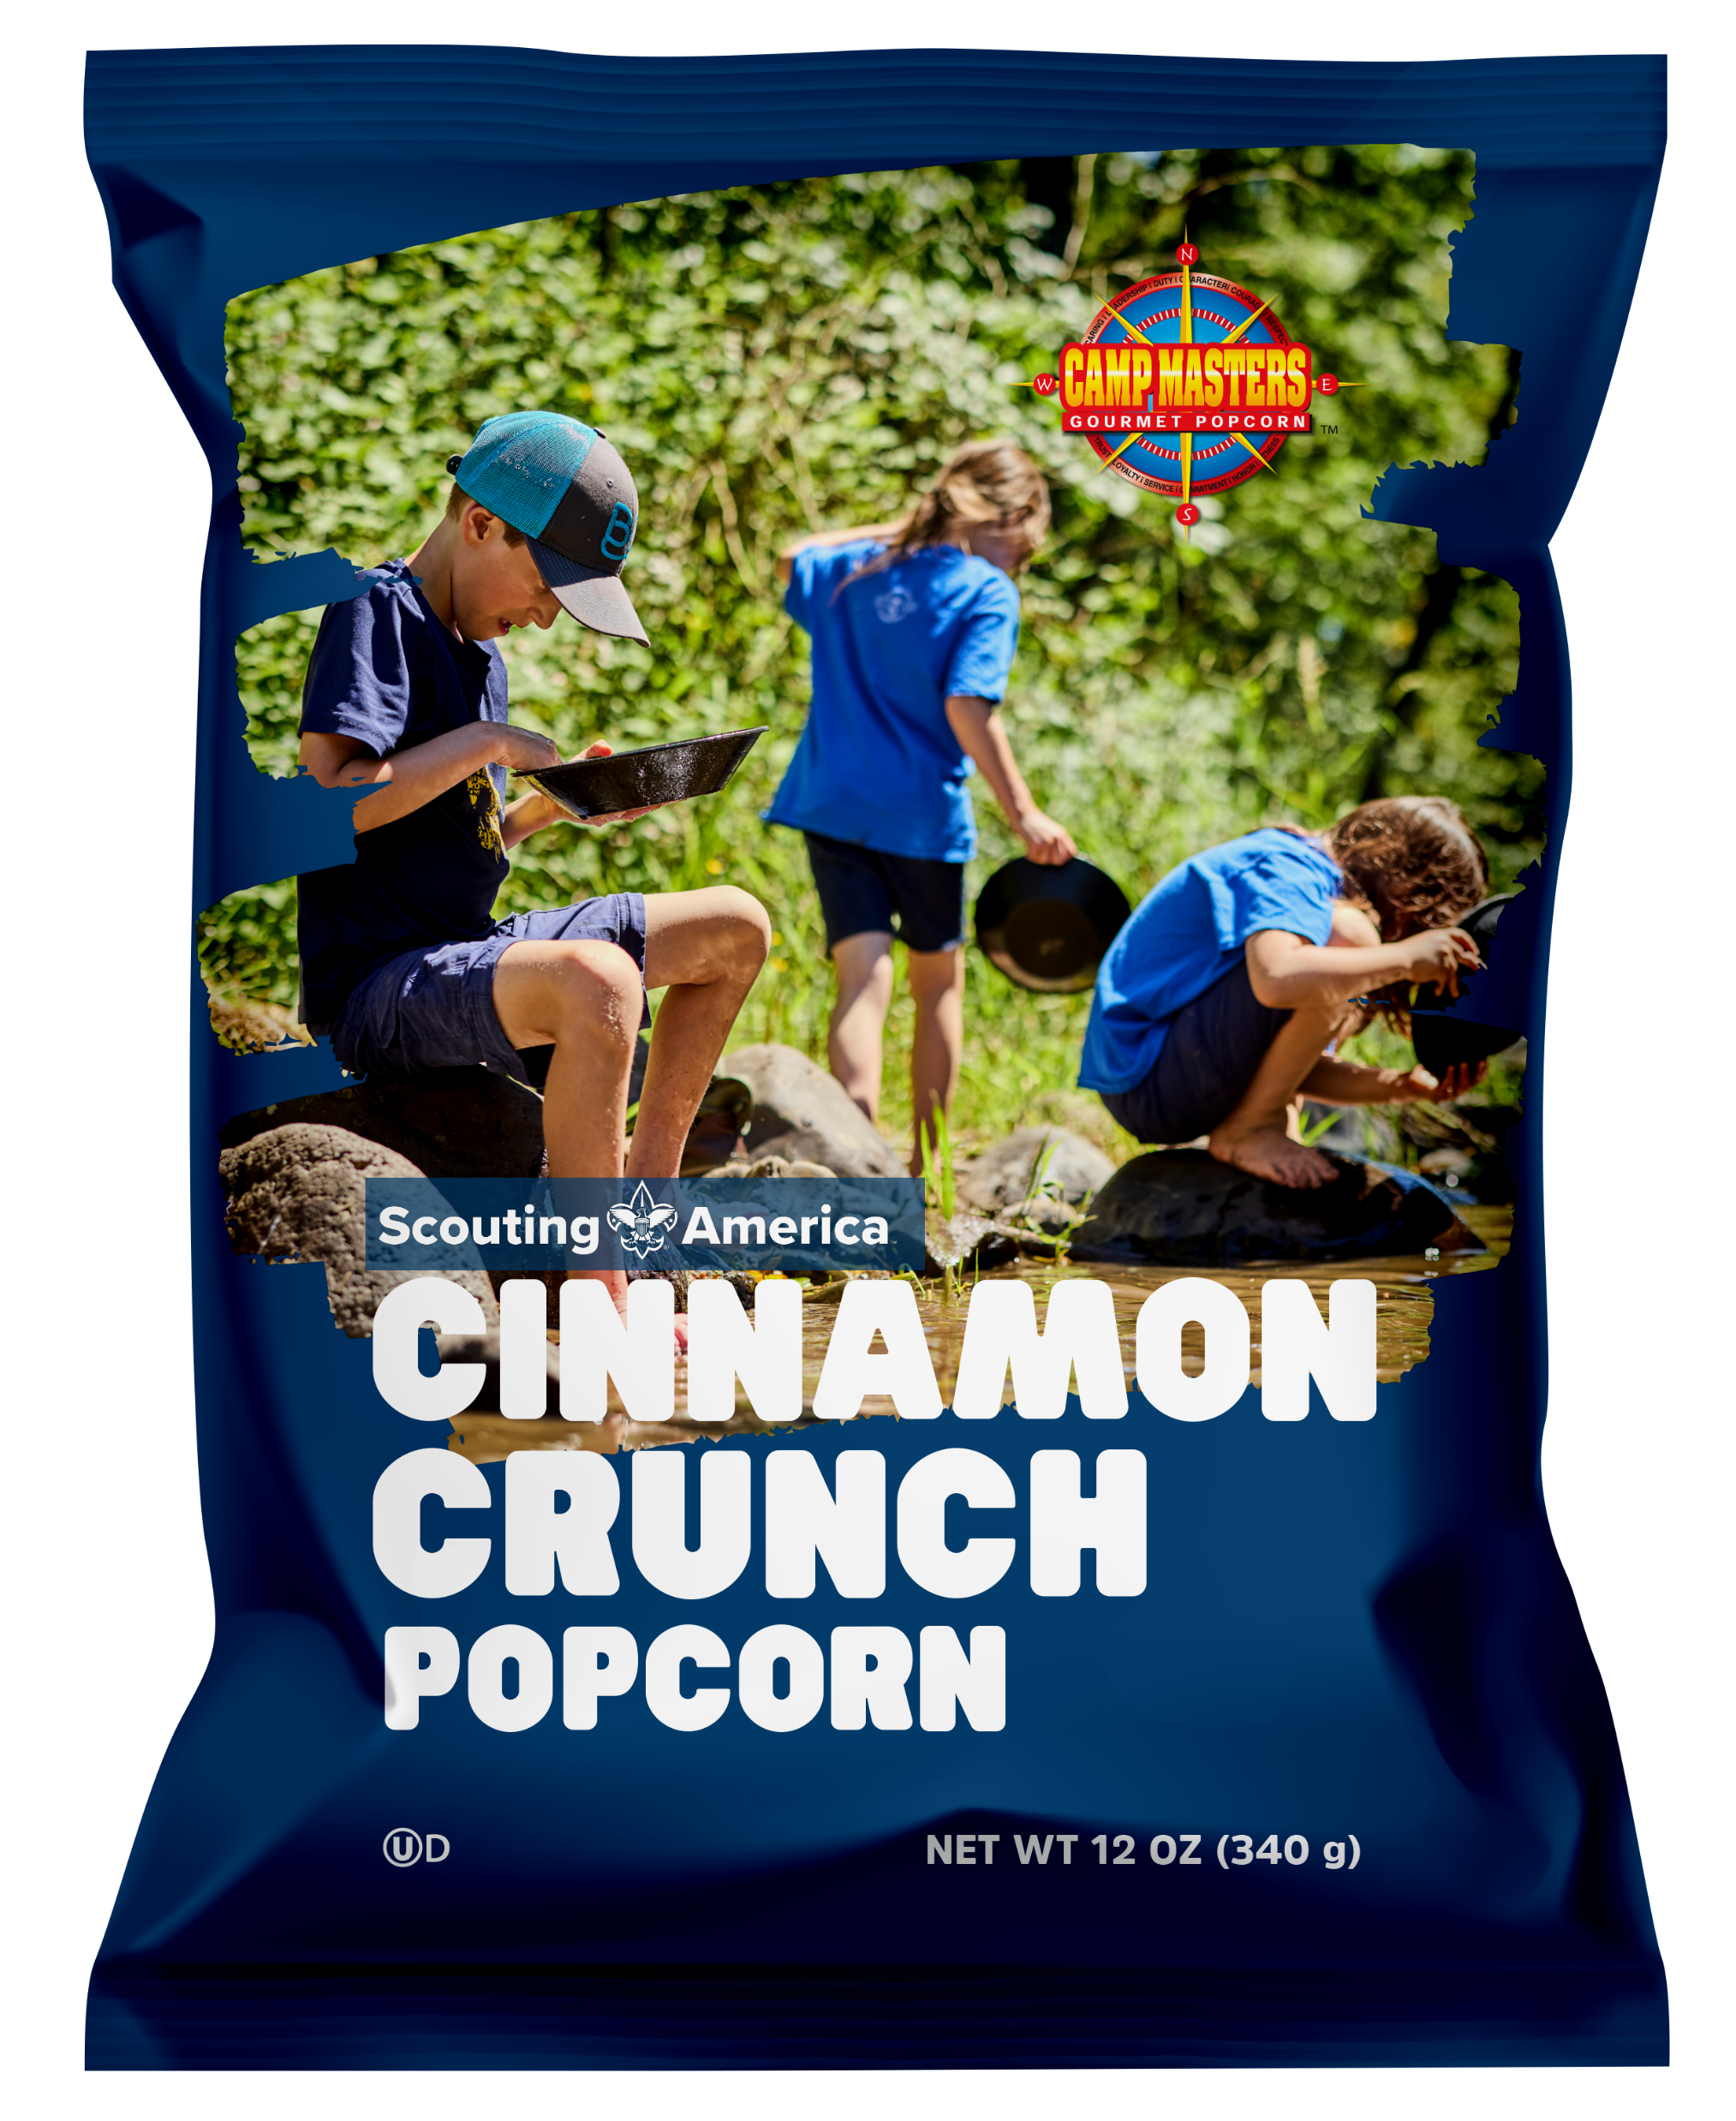
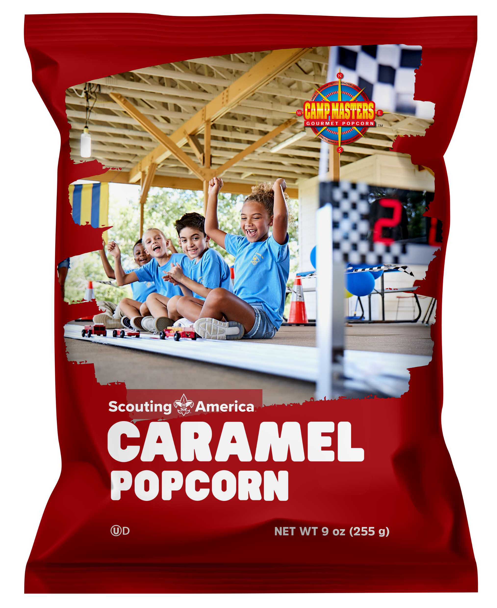
Popcorn Line Up 2026
TEST
$50 & $30 Military Donation
18 Pack Movie Theater Extra Butter Microwave Popcorn
Supreme Caramel with Nuts
Classic Trail Mix
12 Pack Extra Butter Roasted Summer Corn Microwave
Cinnamon Crunch Popcorn Bag
12 Pack Sweet & Salty Kettle Corn Microwave
Caramel Popcorn Bag 10 oz
Purple Popping Corn Jar

Slide 5

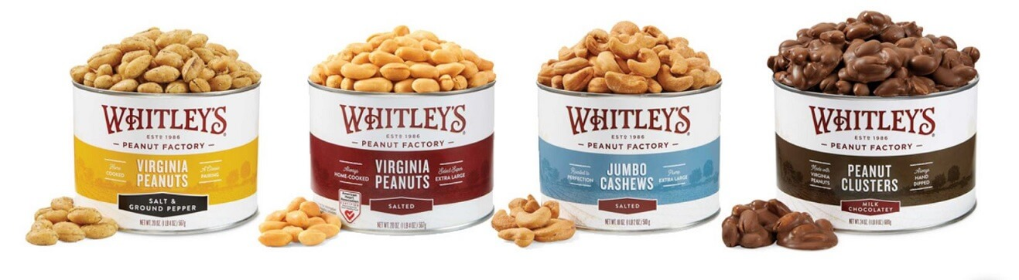
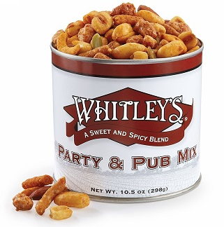
WHITLEY PEANUTS LINEUP 2026
Home Cooked Salted Peanuts 20 oz
Salted Peanuts 12 oz
Honey Roasted Peanuts 20 oz
Honey Roasted Peanuts 12 oz
Jumbo Salted Cashews
Hot Honey Virginia Peanuts
Whit’s Party Mix
Dark Chocolate Peanut Clusters 10 oz
Milk Chocolatey Covered Peanut Clusters 10 oz
Homemade Peanut Brittle
Dark Chocolatey Almond Clusters
Virginia Trail Mix
Notes:
These are the products for the year. You will need to edit the images and prices – each Council sells a different product mix and sets their own pricing. If you need the images, e-mail sean.stanford@trails-end.com and I’ll get them for you.
Get through this slide quickly. Focus on any changes and move on. Don’t get bogged down in discussions about flavors.

Slide 6





Door Prize!

Slide 7

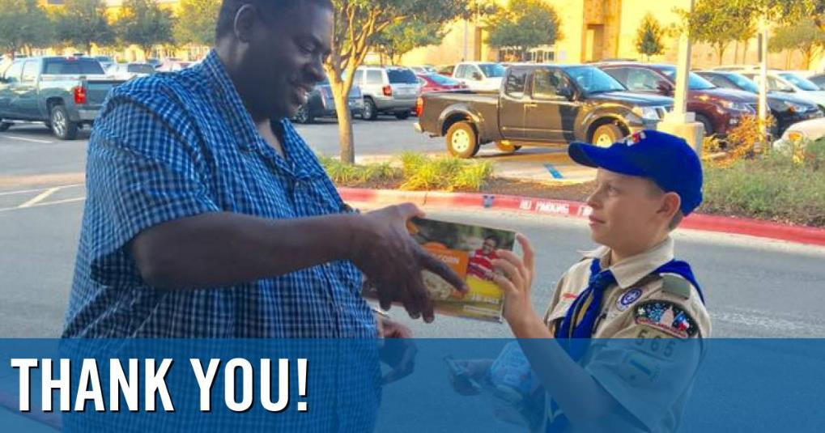
SCOUTS GROW
Character Development
Gain Confidence
Goal Setting
Money Management
Public Speaking
Overcoming fear & rejection
Earn their way…
Notes:
Talk to the parents about WHY we’re selling.

Slide 8

DOOR TO DOOR SALES
Boost your sales!
Sell Door to Door
Sell to Friend & Family
Sell at Work
Sell to last year’s customers
Notes:
Fill in your council’s commission that was paid out. Stress the importance of monies earned

Slide 9


Why
CAMP MASTERS Popcorn & WHITLEY’S Peanuts?
You will earn
GREAT PRIZES!!

Slide 10
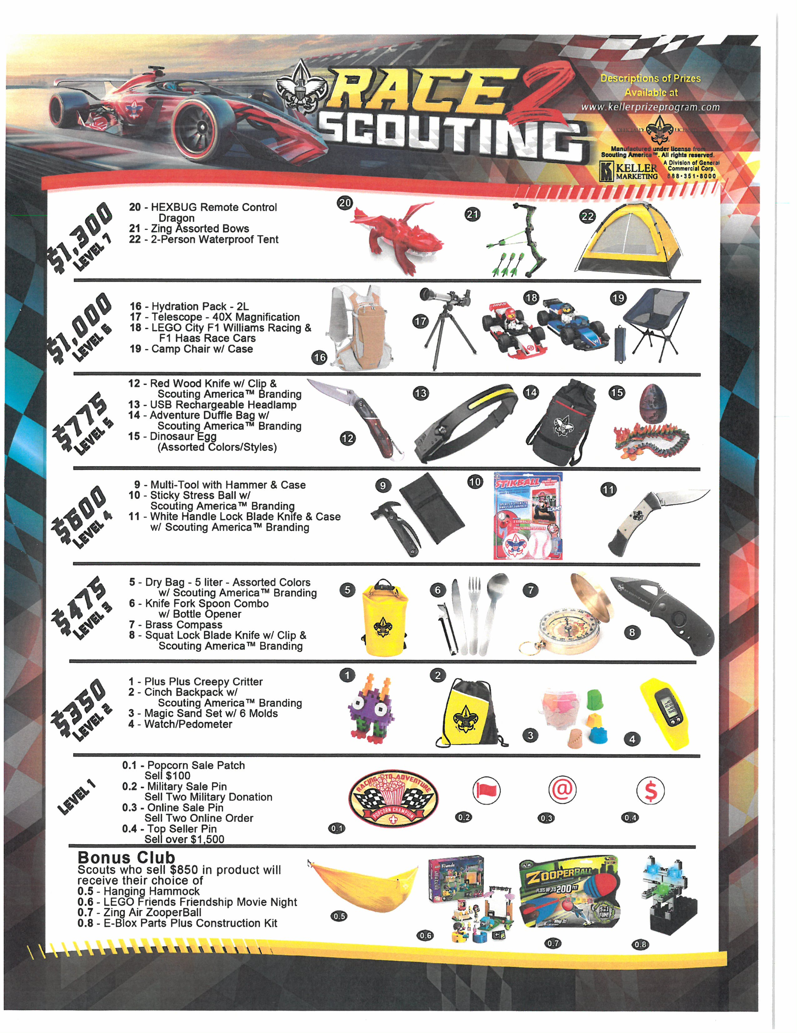
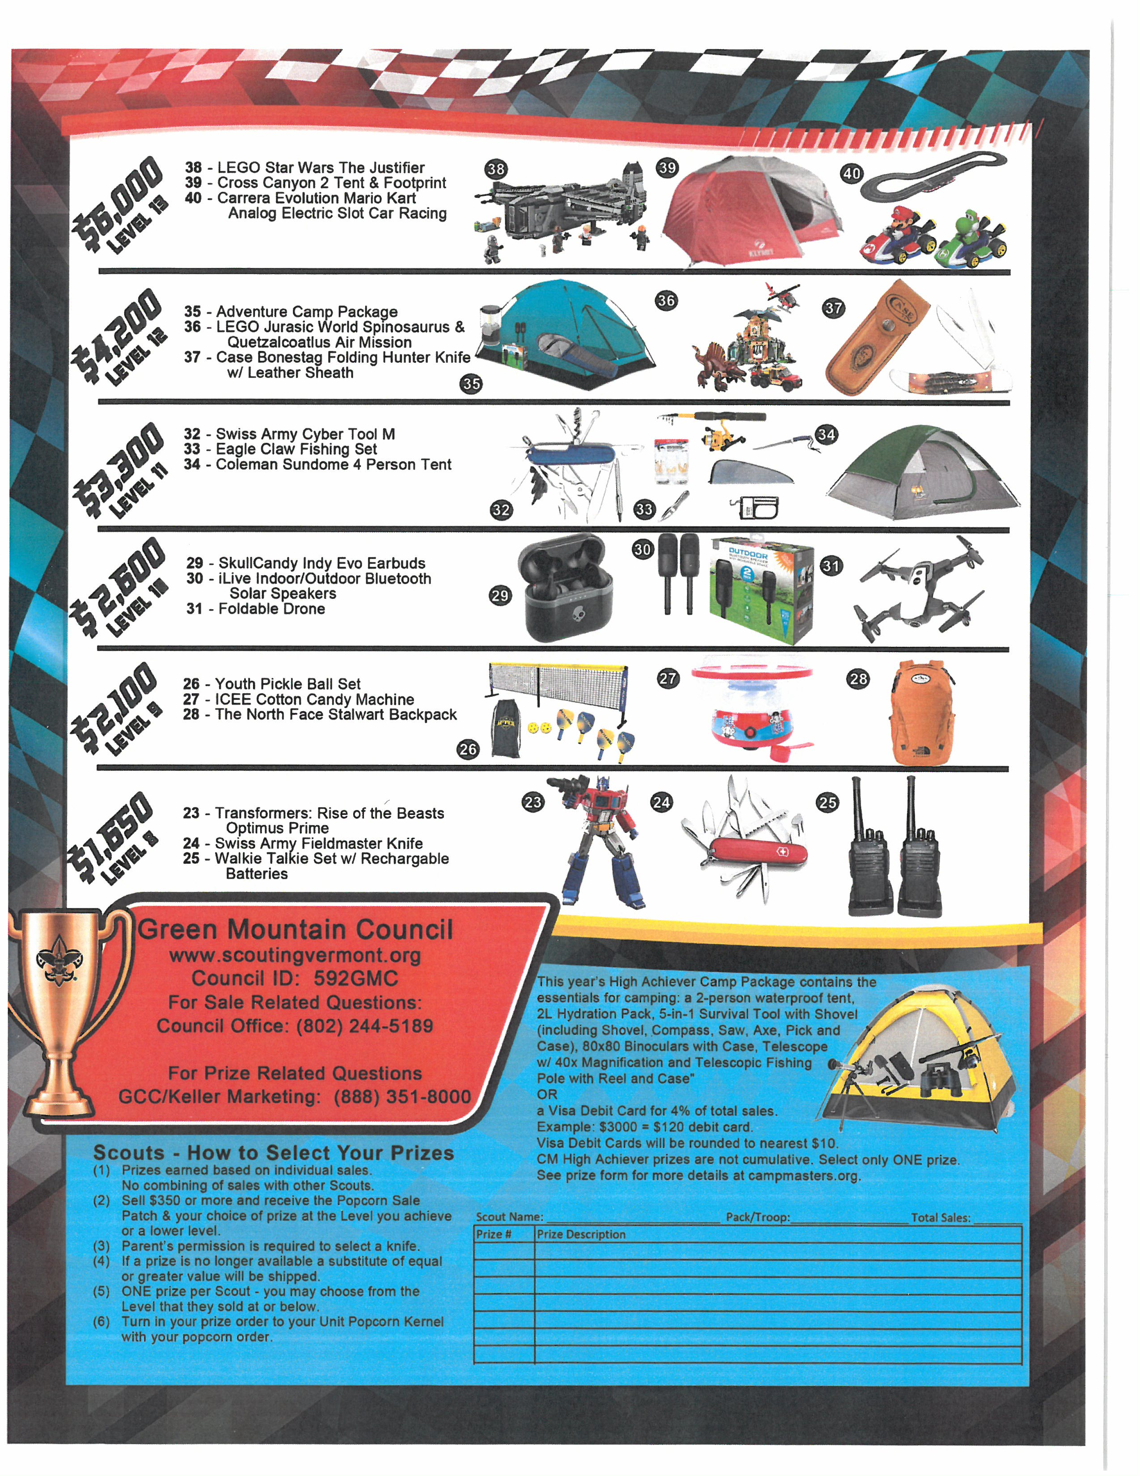
Prizes!!!
Why CAMP MASTERS Popcorn
& Whitleys Peanuts?
Check out the awesome prizes you can earn by selling popcorn & peanuts this year!

Slide 11









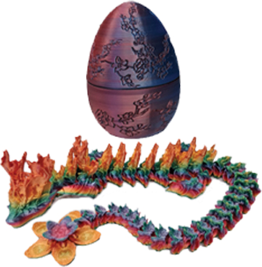
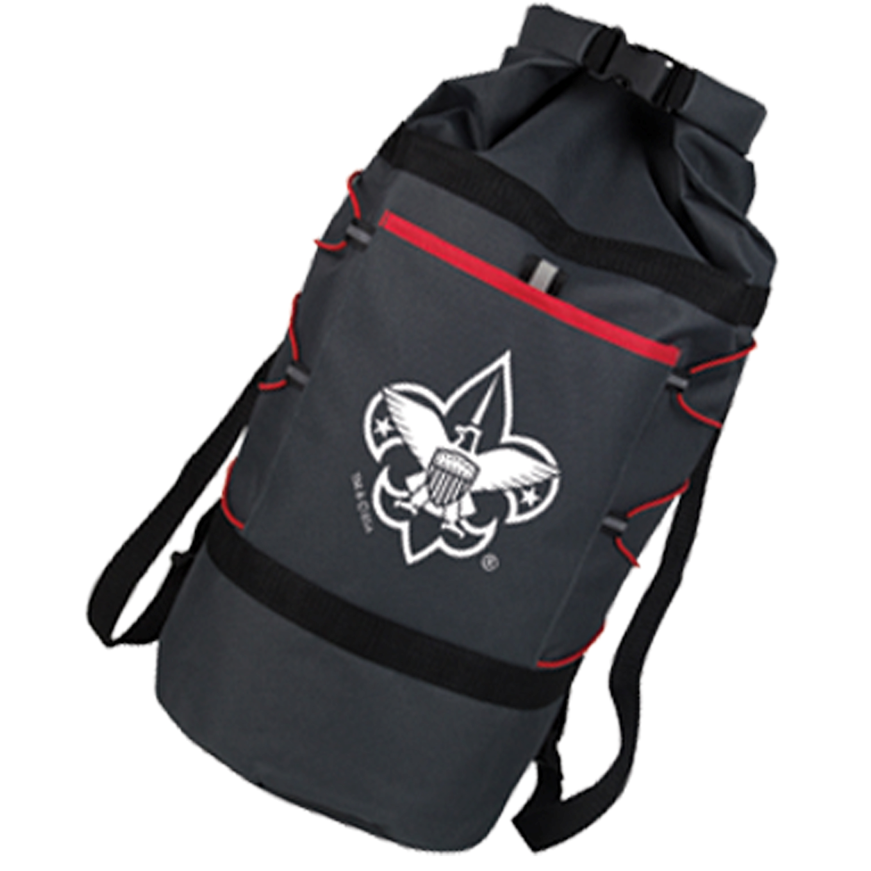
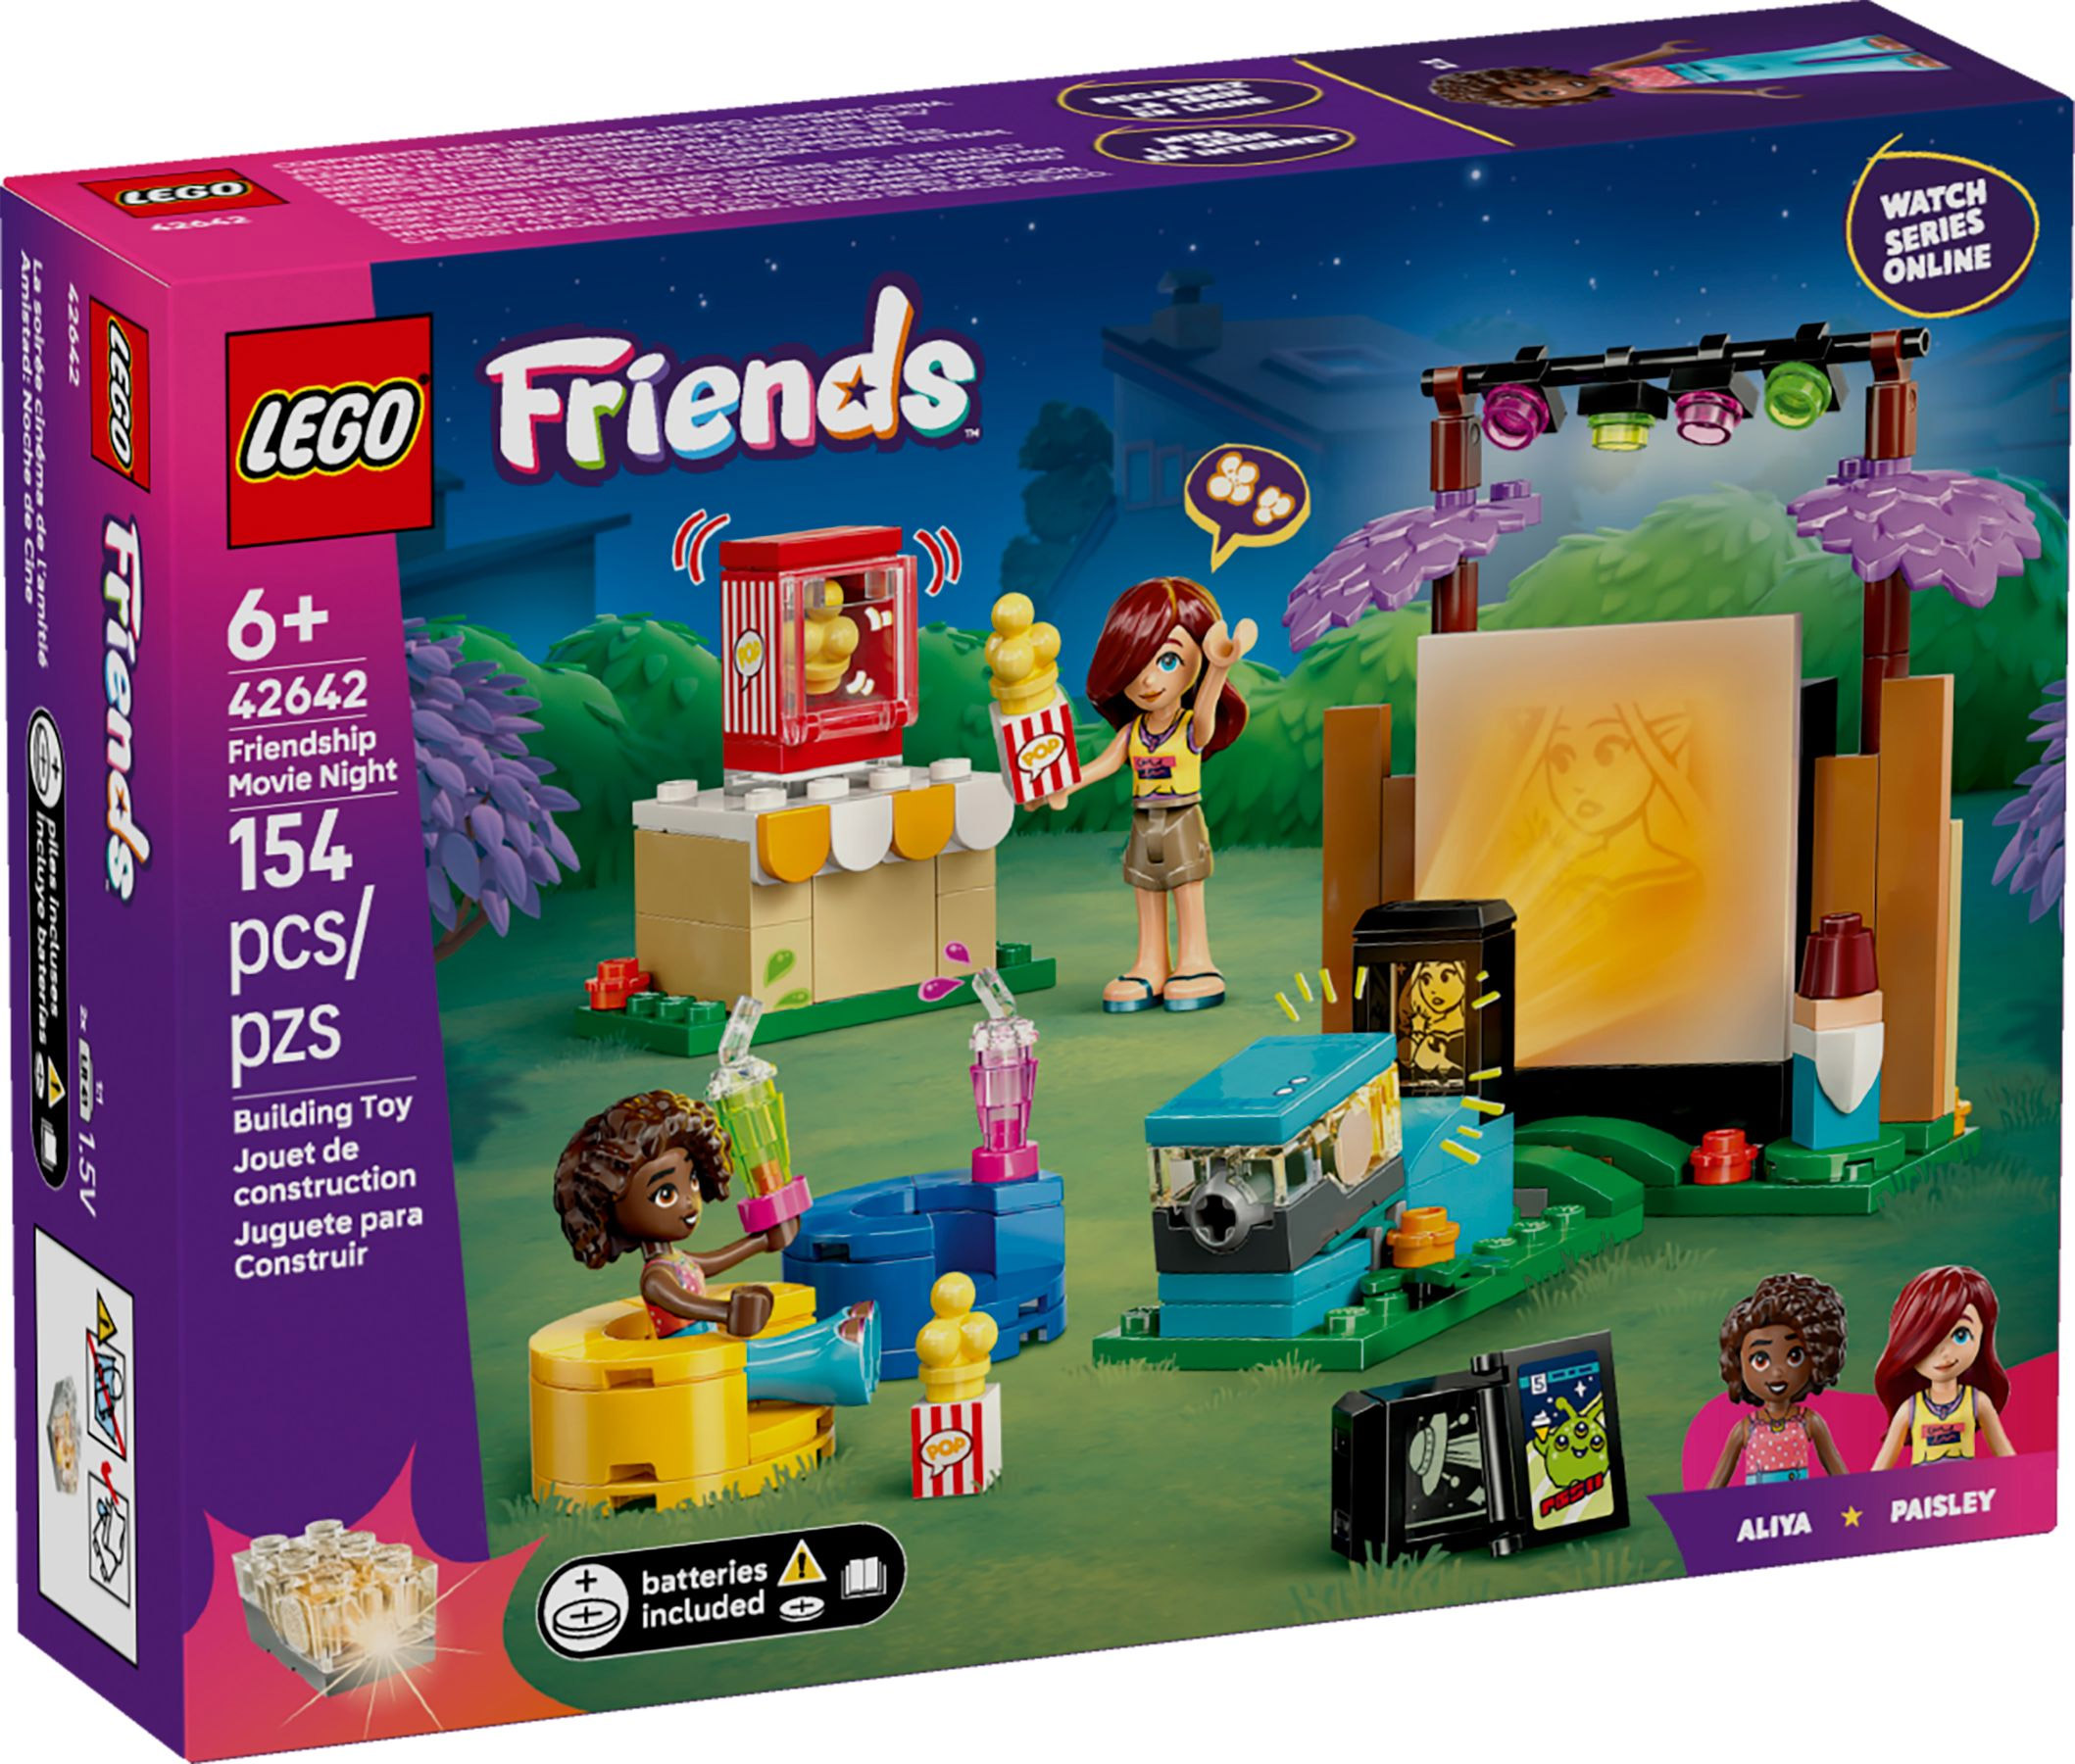
$850
Example: If a Scout Sells
Choose One:
Hanging Hammock
Zing Air ZooperBall
Lego Friends Friendship Movie Night
E-Blox Construction Kit
Sell $100 earn Patch
Sell 2 online earn Pin
Sell 2 Military earn Patch
Sell over $1,500 earn Pin
Prize Level $775
Choice of Prizes:

Slide 12


Thinking of being a Top Seller?
Sign the Pledge!
This year, I will be a Top Selling Scout to earn my way and support my Unit and Council. My goal is to sell $3,000 or more and earn my CampMasters High Achievers Prizes . I will follow the Scout Law, and be Trustworthy, Loyal, Helpful, Friendly, Courteous, Kind, Obedient, Cheerful, Thrifty, Brave, Clean, and Reverent. I will always do my best.
Scout Signature: ____________________________
Parent Signature:

Slide 13


Slide 14
Door Prize!

Slide 15


GAME TIME!
Scouts - head outside for some fun popcorn games!
Parents – come sit up front!
Notes:
Send the Scouts Outside with the Cubmaster and a couple of Volunteers. Play Popcorn Games & Identify

Slide 16
Our Sale!!!!
Show N Sell & Take Order & Online
Our Unit Goal is $______
How to sell…

Slide 17

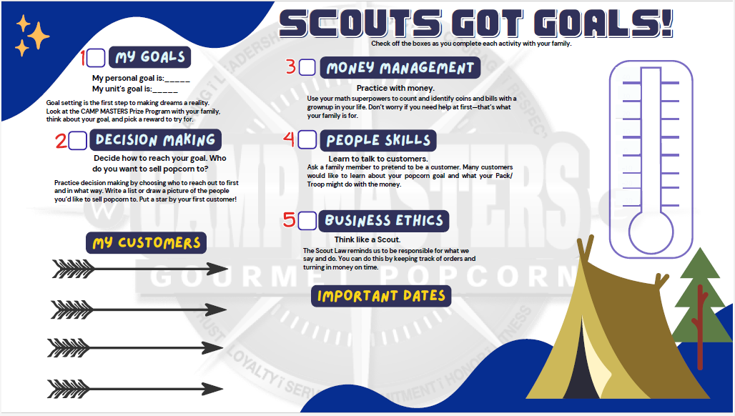
Set yourself a goal to and create a sales script
HAVE FUN!

Slide 18
How to sell…
How to sell…
Scout Demonstration
“Hello sir / ma’am, my name is __________,
and I’m a scout with Pack /Troop_____. You purchased popcorn/peanuts from me last spring. We’re helping our Pack/Troop raise money for _____. You can help us by buying some of our delicious popcorn or peanuts.
You’ll help us out, won’t you?
Notes:
Invite two Scouts to the front of the room to role play a consumer and selling Scout.

Slide 19
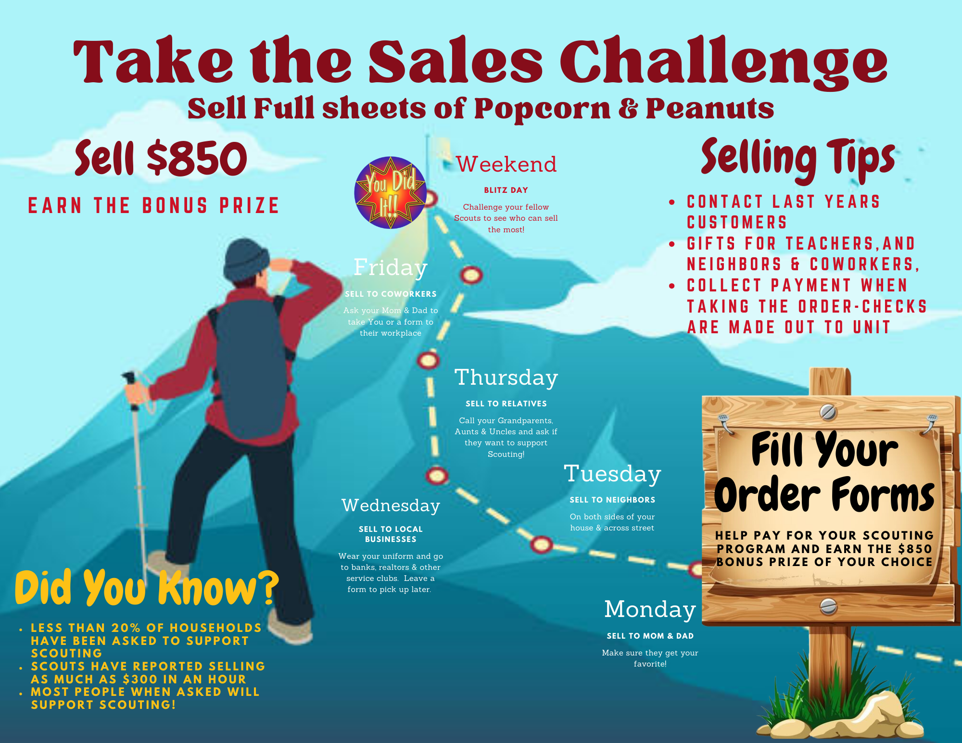

Slide 20
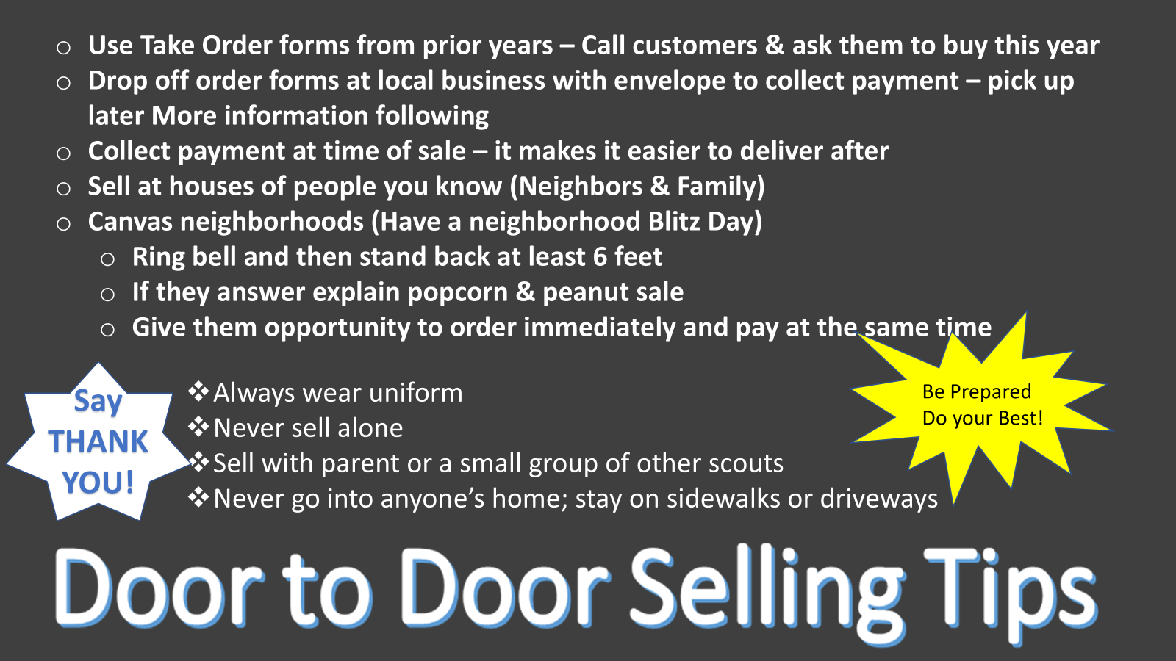

Slide 21
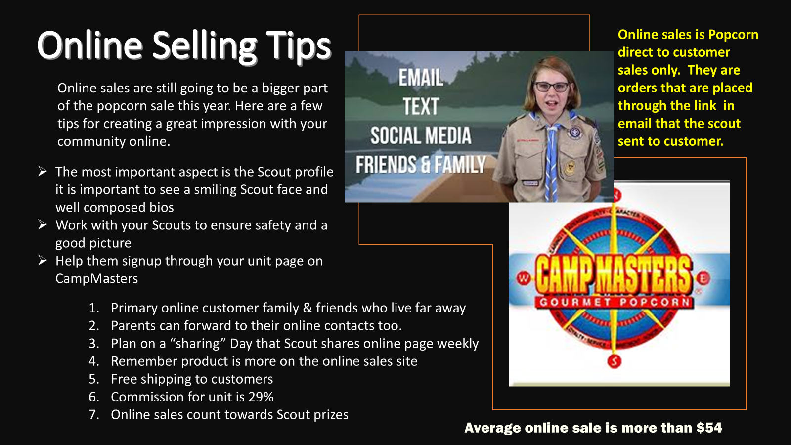
Online sales are still going to be a bigger part of the popcorn sale this year. Here are a few tips for creating a great impression with your community online.

Slide 22

KEY DATES
Take Order sales from March 21st through April 26th
Online sales during these dates count towards the Green Mountain Council Prizes.
Take Order/Rewards Order Due:
Popcorn Pick-Up:
Money Due:
Unit sets date
Unit sets date
Unit sets date
Notes:
Key Dates & Info

Slide 23

CONTACT INFORMATION
John Smith: Popcorn Team Leader
johnsmith@example.com
123-555-5555
XYZ: Popcorn Team Member
Notes:
Provide contact information for key members of your popcorn team.

Slide 24
Thank you Have a Great Sale!!

